Slide 1
Pairs Trading
Wenyu (Kelly) Shen
October 10, 2025

Slide 2
Methodology
Project Step:
Grab 10 years PEP and KO adjusted prices.
Regression: PEP = KO * beta + spread, calculate correlation matrix between PEP and KO
Simulate the PEP and KO by the Cholesky Decomposition
Spread = PEP_Simulated – KO_Simulated * beta 1 5D
Calculate PnL 5TH and 95th, determine the pairs trading in and out condition

Slide 3
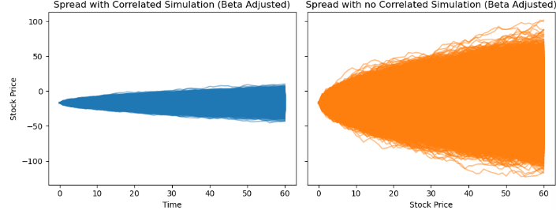
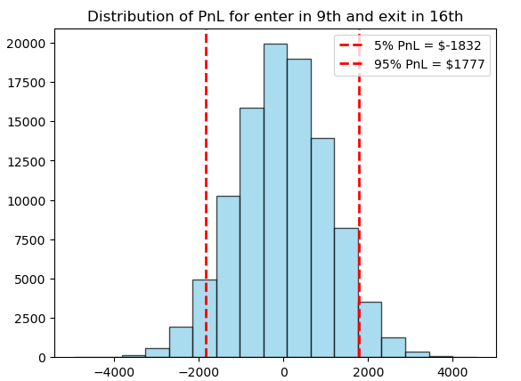
Simulation Result
Expected Return for this trade: $-19
5% PnL = $ -1832
95% PnL = $ +1777

Slide 4
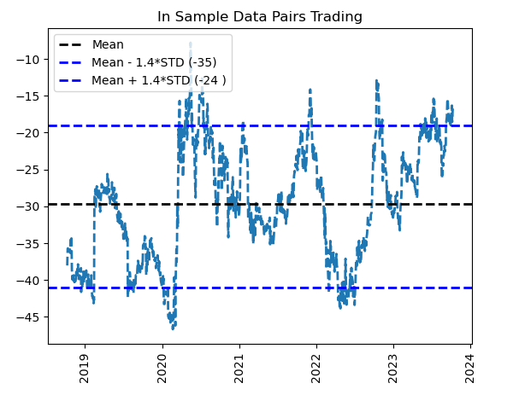
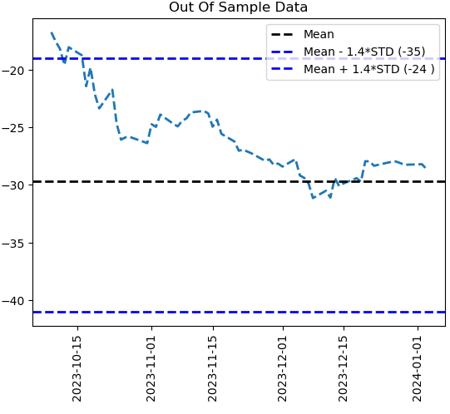

Pairs Trading Strategy
Exit and In Condition:
Upper Bound = mean_spread + 1.4 std(Spread); Lower Bound = mean_spread - 1.4 std(Spread)
When spread hit above the upper bound, long KO short PEP, close the position when spread hit the median
When the spread hit below the lower bound, long PEP short KO.
Assumption:
Could buy any (float) number of share.
The trading Cost is 15 bps per trade.
Threshold (1.4) Determination Process:
Boundary = mean – a * std, choose a from 0.5 to 2, brute force per each a to do the back testing and check for the performance in in-sample and out of sample. With the a = 1.5, the 60 days cumulative PnL by executing the trade has return with $5884.

Slide 5
Thank you!

Slide 6
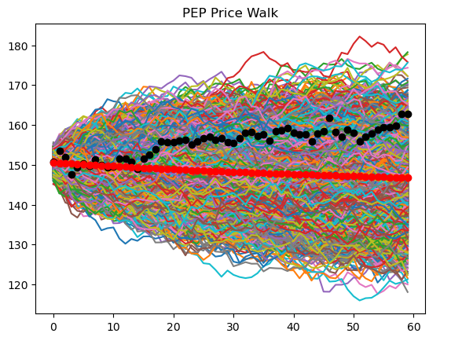
Appendix 1: Different Approach
Project Step:
Pull data, PEP, KO, spread = PEP-KO
Detrend the spread to stationary: spread = t* beta + detrend spread, then do Stationary Test
Use Brownien motion to simulate KO, use OU mean reversion process to simulate spread.
Predict the PEP = simulated KO + reverse detrended simulated OU.
The black line in the plot is the realized PEP price for next 60 days, changed to another approach due to the trend was not captured.
Notes:
We also did a performance attribution to break down the excess return into asset allocation and security selection effects.
From the graph we can see that our fund underperform the benchmark in both allocation and selection.
The best allocation is the Real Estate sector where we allocate 12% more than the benchmark, but we did bad in allocating the financial sector so it detracted 1.3% value add
For security selection.
For the security selction, the Information Technology manger was able to identify stocks that performs better than the benckmark IT stock which creates 0.4% value add.
However, the energy manager failed at identifying better stocks and we

